Slide 1
Kathleen Tuite
November 19, 2013

Slide 2


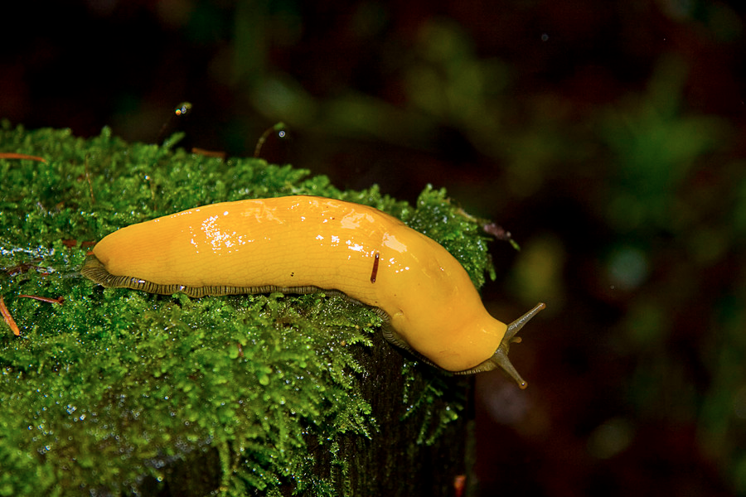
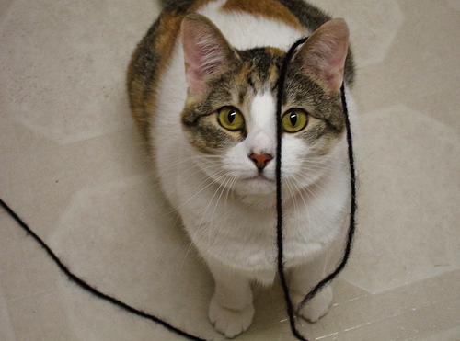
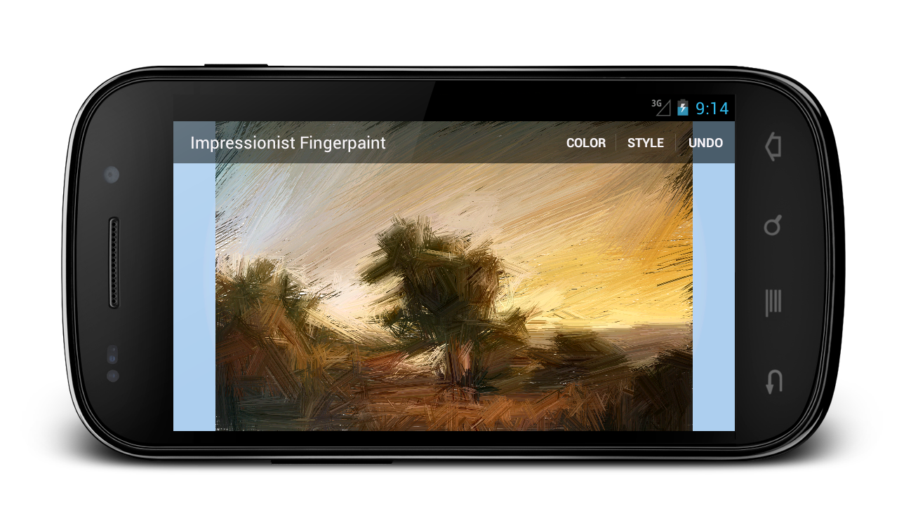
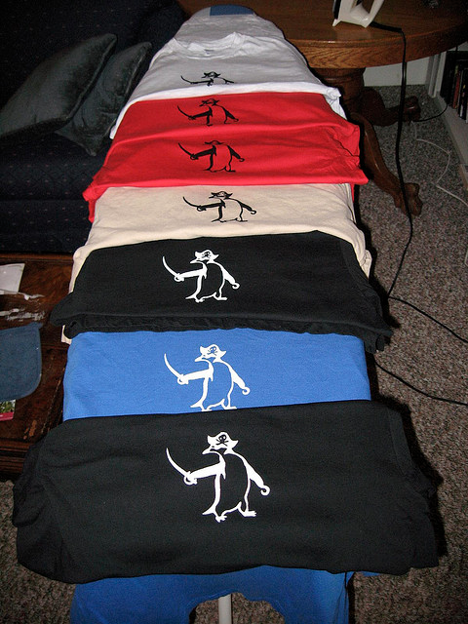
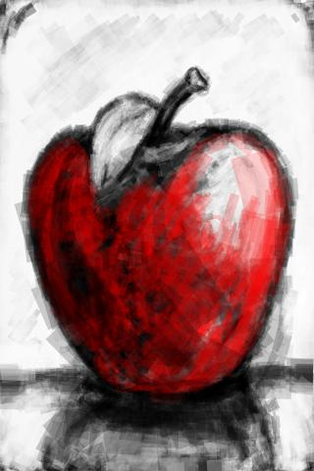
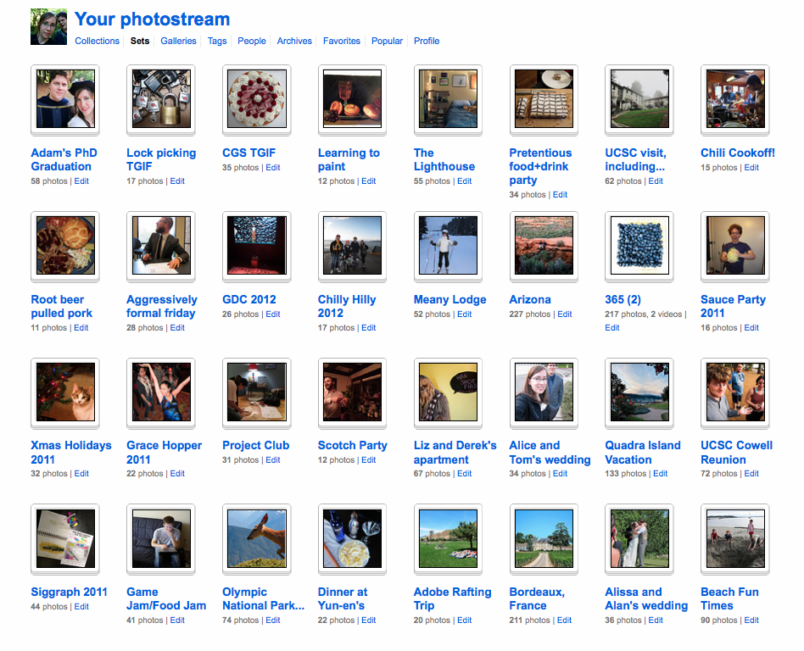
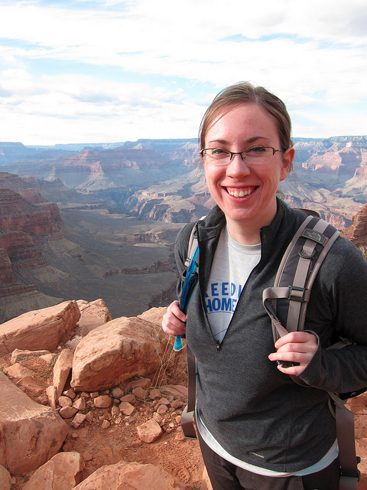
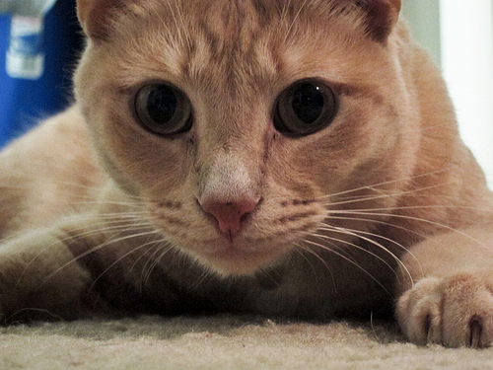
Notes:
UW, UCSC, bananslug mascot, take pictures, screenprint pirate penguin t-shirts, go hiking, kittycats, creativity-enabling android drawing apps

Slide 3
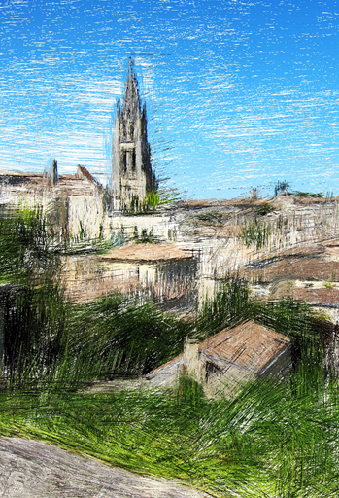
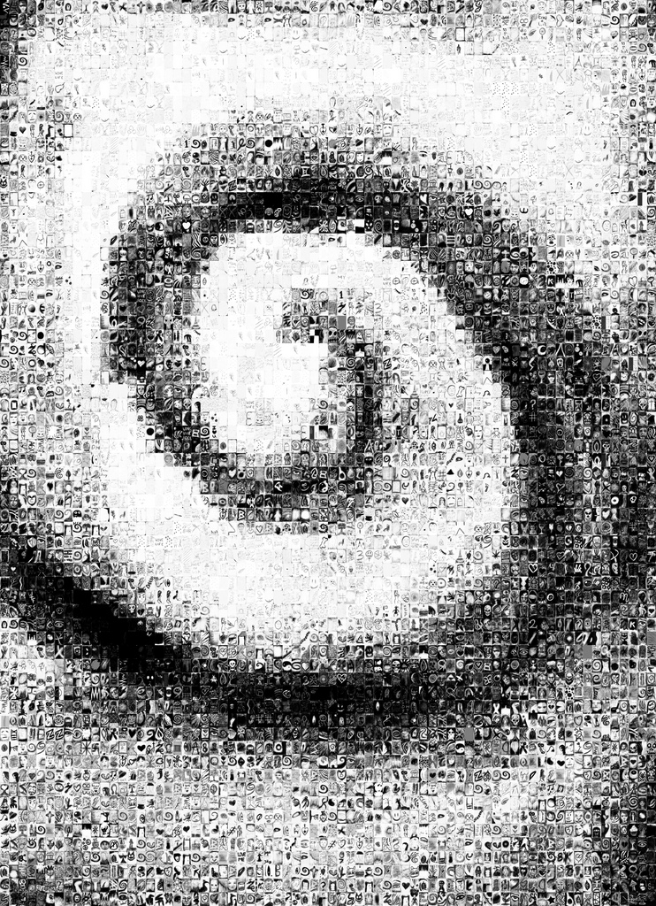
Impressionist Fingerpaint
Sketch-a-bit

Slide 4
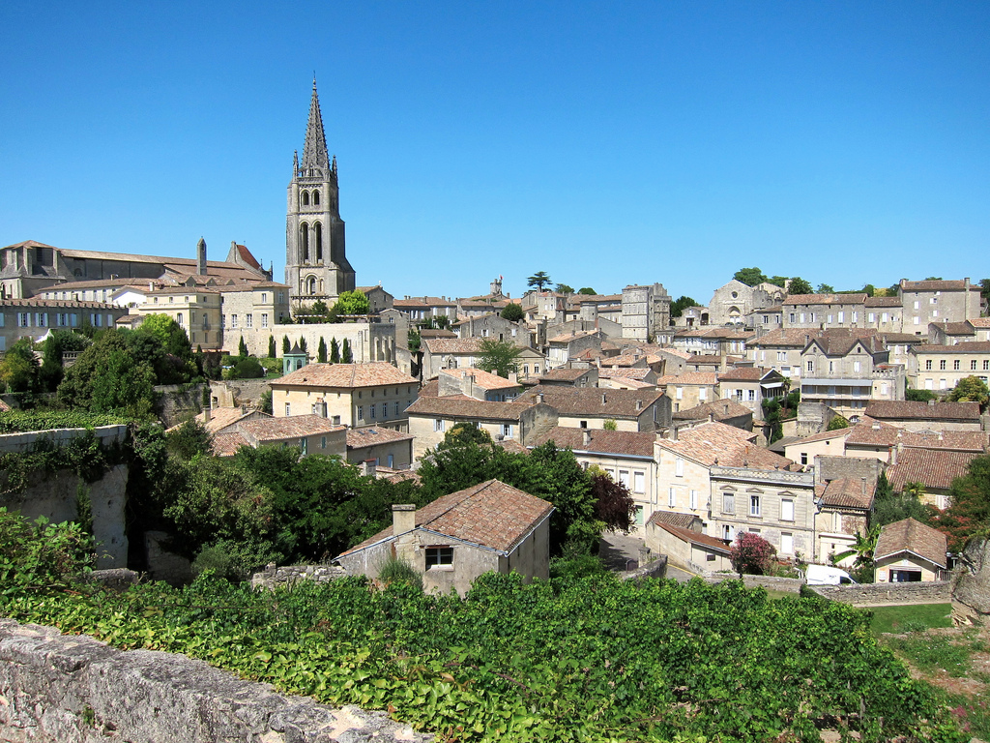

Slide 5
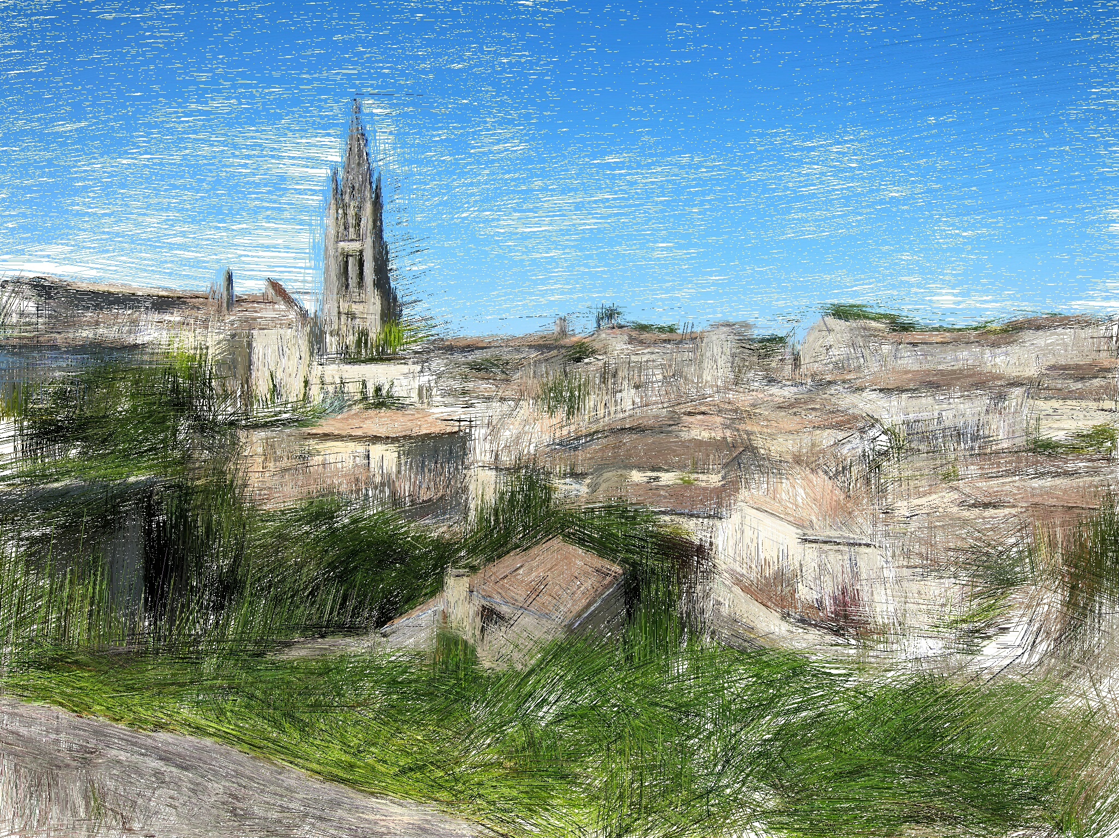

Slide 6

Processing: live demo!
https://processing.org

Slide 7
Cool sketching app, made in Processing
…
Can we make sketching collaborative?

Slide 8
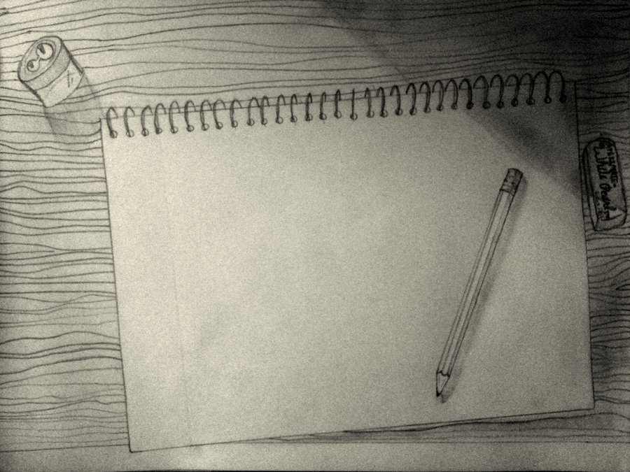
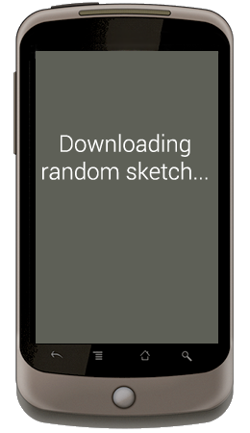
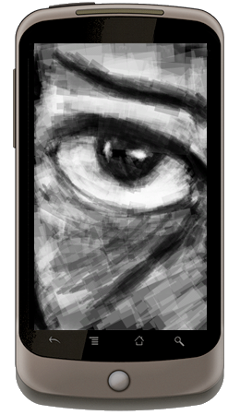
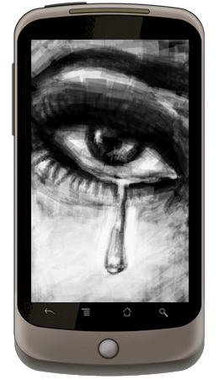
What should
I draw?
http://sythirra.deviantart.com/art/What-should-I-draw-today-180310724
Notes:
We made an android app for casually sketching and drawing. Sometimes you don’t know what you want to sketch, so
Our app randomly downloads a picture that someone else drew and lets you paint on top of it.

Slide 9
Sketch-a-bit
Deployed 3.5 years
147,349 sketches
http://sythirra.deviantart.com/art/What-should-I-draw-today-180310724
Notes:
The app is called sketchabit
Its been deployed bla bla bla
And this paper is about what people drew and uploaded.

Slide 10
Crowdsourced Art
Whirlwind tour!
Notes:
Some existing things that you should know about that are very cool that you should take some time to check out on your own.

Slide 11
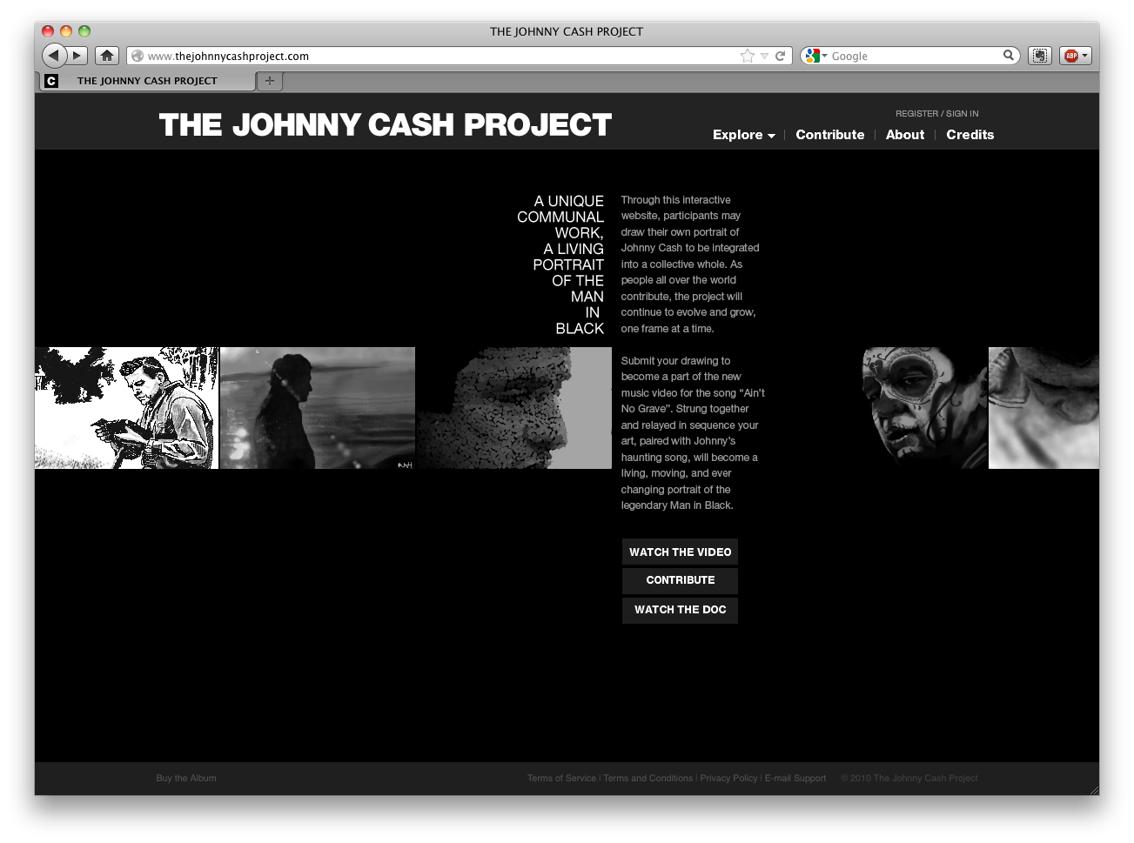
Notes:
Visually most similar to ours because of the grayscale hand drawing style… but a very different contribution model.
Crowdsourced music video of a johnny cash song where each frame in the video is a hand-drawn frame of an original input video.

Slide 12
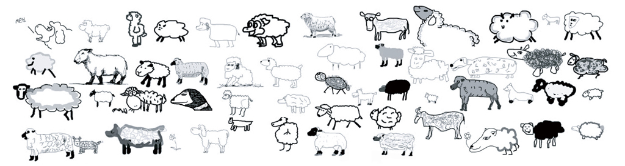
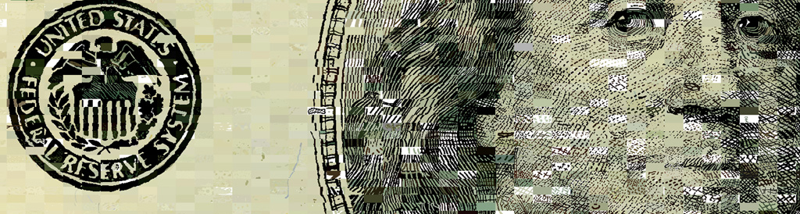
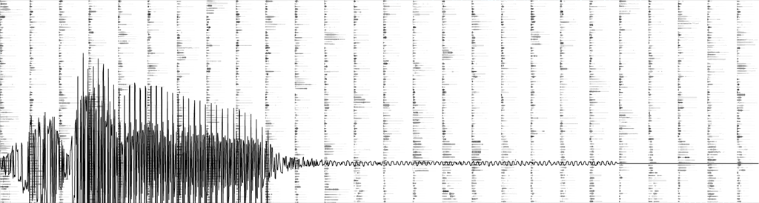
The Sheep Market
Ten Thousand Cents
A Bicycle Built for Two Thousand
(all by Aaron Koblin)
Notes:
Here are 3 projects that were all done through mechanical turk
In the sheep market, people were paid 2 cents to draw a sheep facing to the left
In this ten thousand cents, people were paid to draw a small chunk of an image of a 100 dollar bill
And in this bicycle built for 2,000 people imitated one-second clips of a song and these were composited together in the end.
These were all the work of aaron koblin who also worked on the johnny cash project.

Slide 13
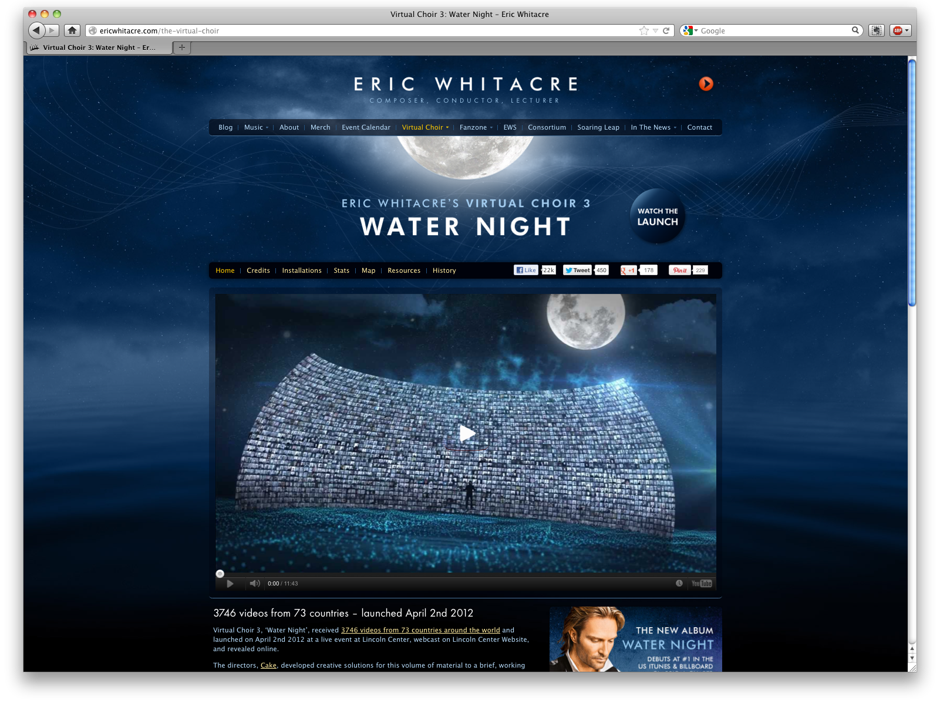
Notes:
The last slide that mentioned the bicycle built for 2 thousand, the end result was interesting but doesn’t sound very pretty.
On the other hand, eric whitacre is a professional composer and put together this virtual choir project.
Thousands of people
Inputs: video of conductor gesturing for the different pieces of the composition
Output: individual videos of people singing
Later curated and merged together

Slide 14
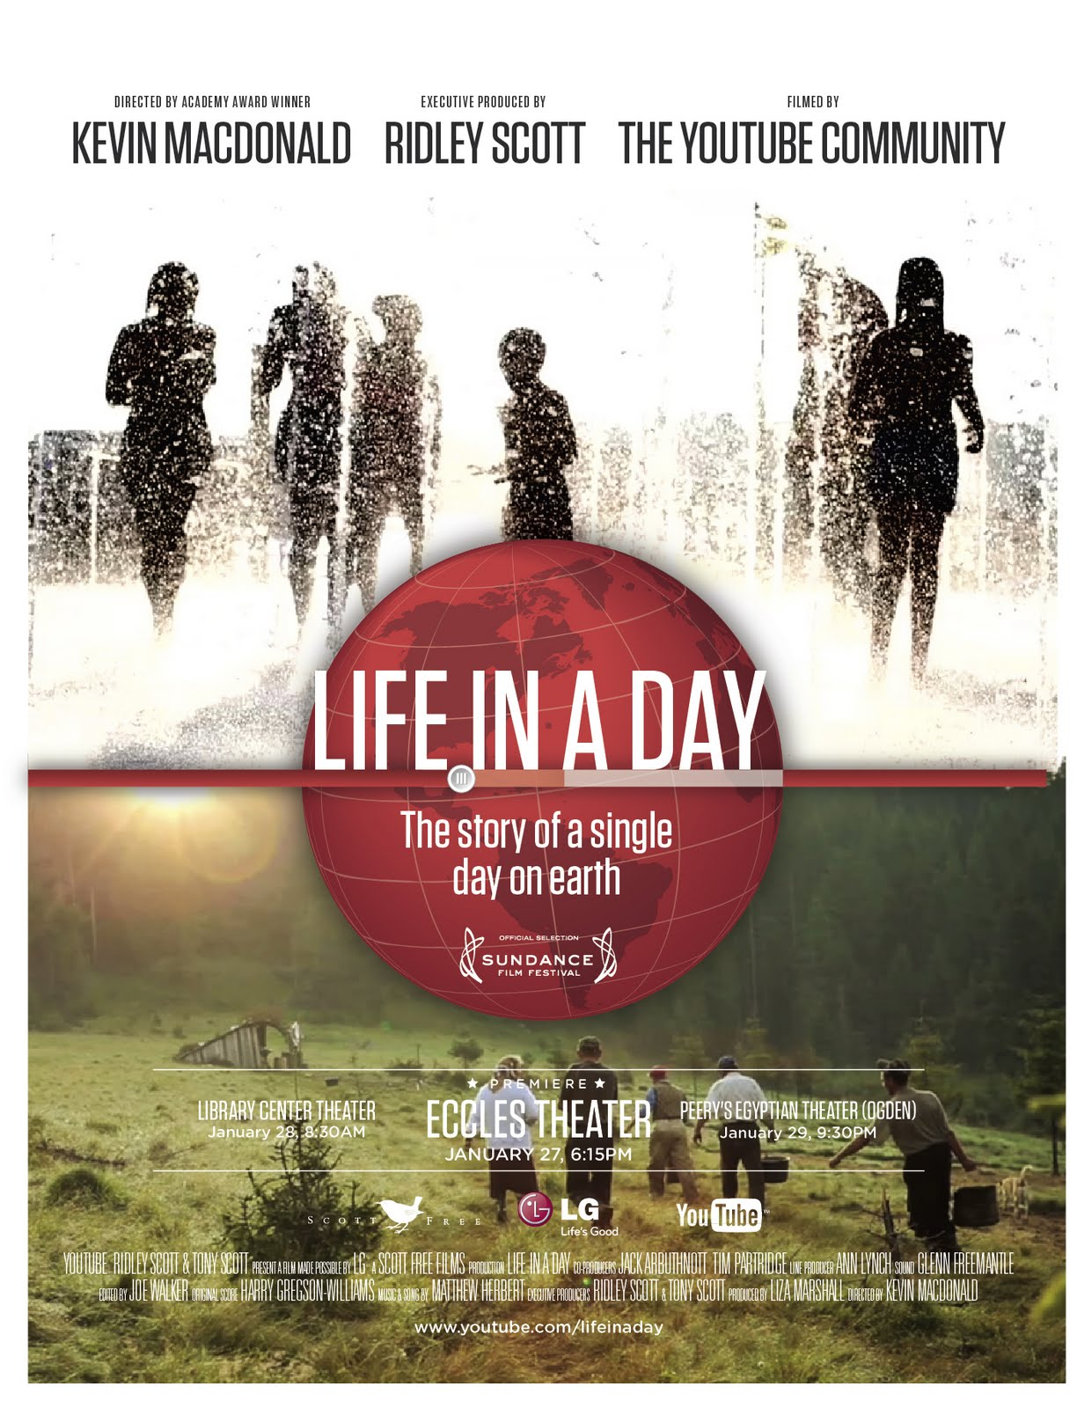
Notes:
This has been done with video, too with this life in a day project
Where thousands of people’s clips all from the same day were collected and arranged into a 90 minute film that premierd at the sundance film festival.

Slide 15
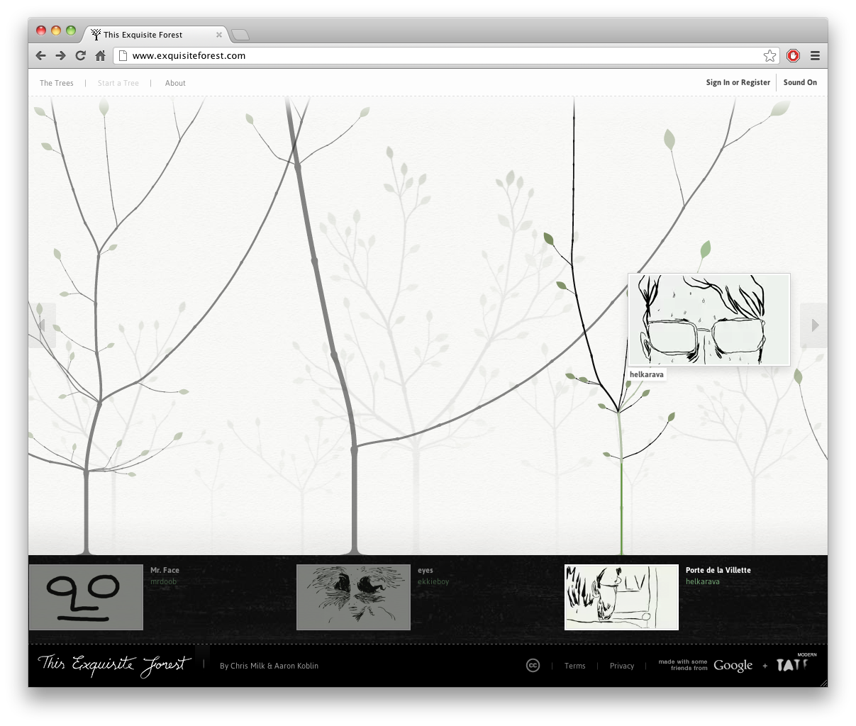

Slide 16
Models of Collaboration
Working together vs. working alone
Notes:
Let’s look at the structures behind these.

Slide 17
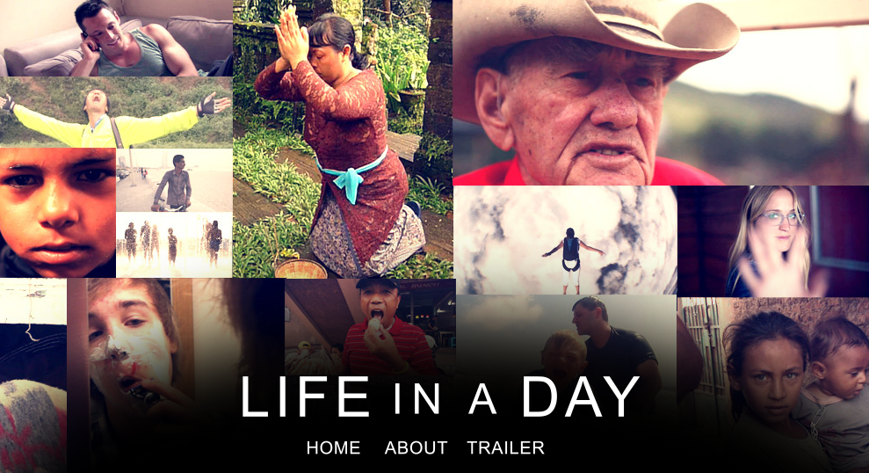
Flat contribution model (v1)
Life in a Day video project:
Capture video from your life on July 24,2010!
user videos
(80,000 submissions)
expert curation
working in isolation
Life in a Day movie
Notes:
First model I want to talk about is the flat contribution model. Our example is the life in a day video project and also things like the cat book, the sheep market, where there’s a really simple prompt that is the same for all contributors.

Slide 18
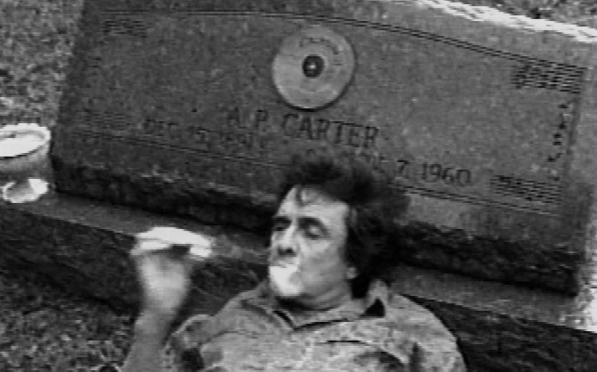
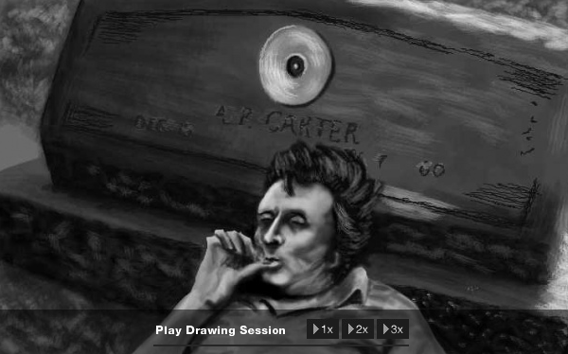
Flat contribution model (v2)
original movie
user drawings of individual frames
mostly working in isolation
final video artifact
Notes:
This is pretty similar to the previous one but there’s more differentiated source material here and like in the johnny cash project, or the ten thousand cents, different people draw different things based on different input.
but this is just the map phase of what’s essential a human map reduce.
These folks working on the johnny cash video do get to see some of the other frames that other people have drawn so they’re not totally isolated frm each other.

Slide 19
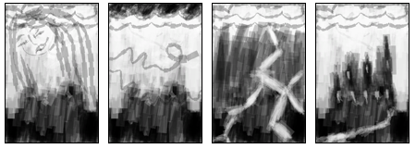
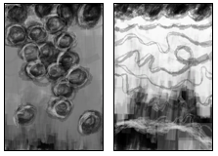
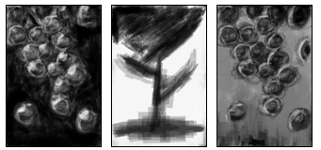
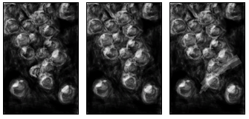
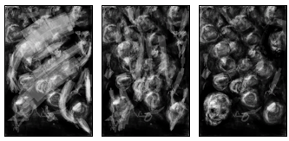
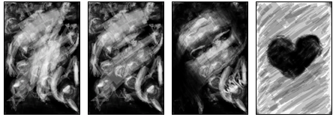
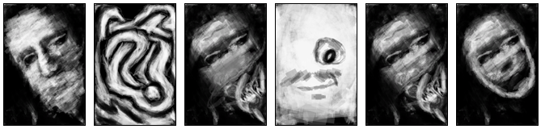
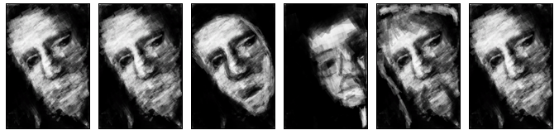
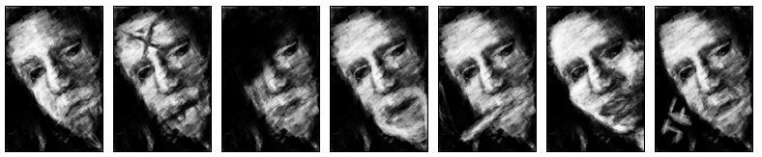
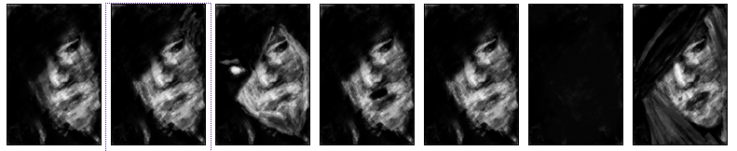
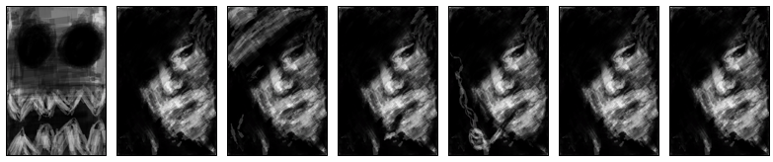
Hierarchical contribution model
White canvas: every sketch’s parent
Notes:
In sketch-a-bit we have a different contribtuion model.
It starts with one input: the blank canvas, but then every sketch is the descendent of another sketch. And different sketches may have multiple children or no children at all.
The essential thing about this model is that you inherit the deep history of every sketch that came before you.

Slide 20
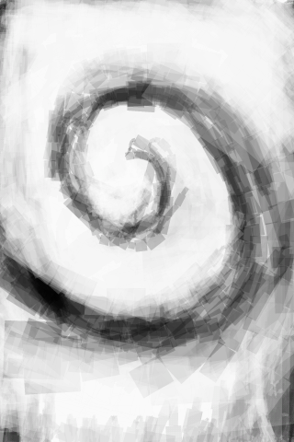
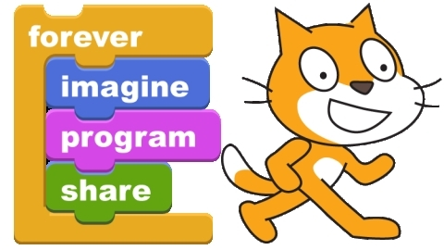
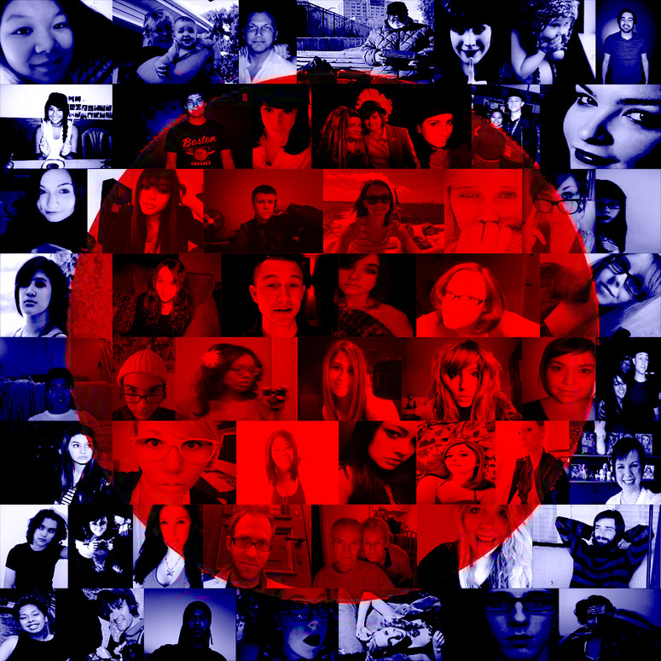
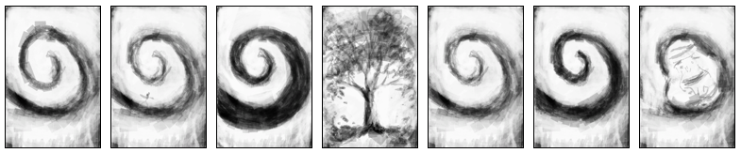
Hierarchical contribution model
Sketch-a-bit is minimal
Notes:
We’re not pioneering this hierarchical contribution model… you can find it in scratch and hitrecord, and this more recent project called Exquisite Forest.
The notable difference bteween sketchabit and these other projects is all common features that it doesn’t have, like users accounts and top-rated lists.
And because it’s simpler it lets us look at this hierarchical contribution model without as many distortions.

Slide 21
Our Design choices

Slide 22
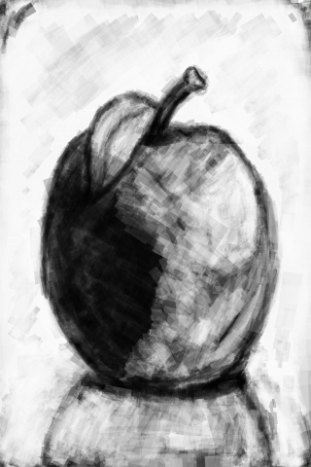
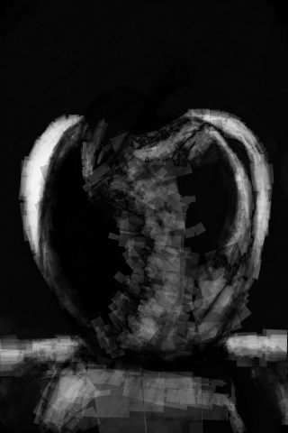
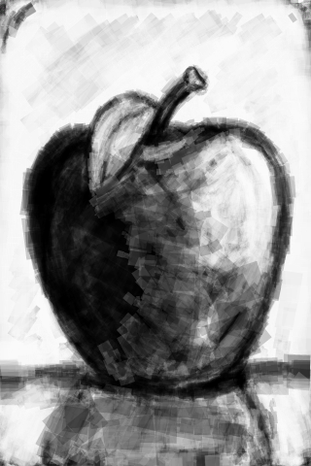
Collaboration
input
difference
output
different pixels drawn by different people
Notes:
Key idea is that different people work on the same pictures. They can choose to keep some visual elements, like the leaf here, and change others, like shape of the apple.
This picture in the middle shows where the work was done … where the image is lighter.

Slide 23
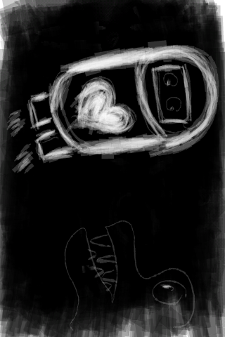
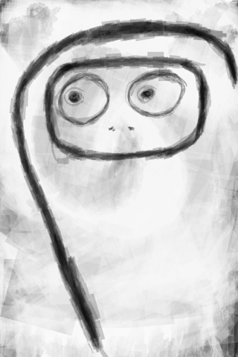
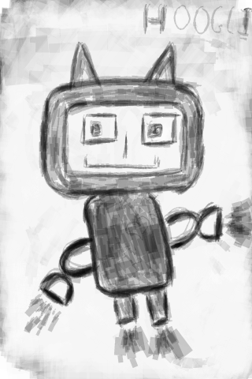
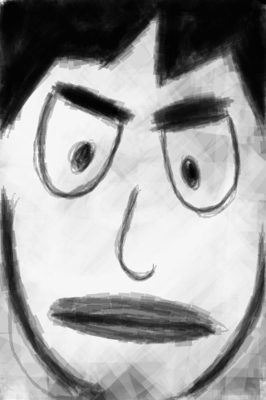
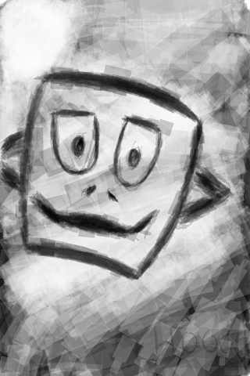
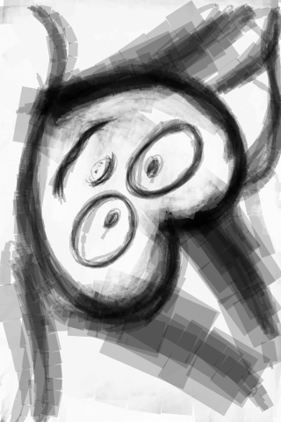

Anonymity
No accounts, signups, logins
No tracking your drawings
No identifying the best/worst artists
No credit, reputation
No way to find out who or why?
Notes:
Read slide
The only clues we get are when a bunch of sketches in a row have a common style or insignia, like these ones that all have similar sorts of faces, leading me to believe they’re by the same artist.

Slide 24




Input type == output type
Notes:
This is probably the most important part of sketch a bit.
You’re given an image as inspiration, you think about it, and you produce a new image. If we stopped tehre, it would be like 10,000 cents or the johnny cash project.
But we take this output and can let it be the input to someone else.
These wind up chaining together.

Slide 25
The Ecosystem of Sketches
Can’t study the humans? We’ll study this instead:
Notes:
Whe don’t have any way to ask the humans why they did what they did, but we can take a closer look at what they actually produced.

Slide 26
Remixing behavior
25% adding/removing/changing detail
20% duplicating
17% unrelated new image
13% refining
9% reworking
7% reimagining
6% new image on blank canvas
3% scribbling
1% preparing a blank canvas
Notes:
After several iterations we settled on these codes and applied them to 300 sketches. we’ll go through these in order

Slide 27



Adding/removing/changing detail
Notes:
This was the most common type of change. A lot of times people changed details related to adding or removing faces on things. And here we have 3 examples of the mouth and the eyes moving around.

Slide 28
Duplicating
Notes:
Duplicating was another fairly common occurrence.
Either people get it and they want chosen sketches to appear more frequently in the pool of sketches
Or they were just using the upload button to get access to a new picture.

Slide 29








Drawing an unrelated picture
Notes:
A lot of the time people just ignored the previous picture… they knew what they wanted to draw so they just went for it. Here are 4 examples of the before and after sketches.

Slide 30



Refining
difference image
Notes:
Commonly manifests as tracing. Making a picture look more like what it seems like it already is.
The difference image here highlights how most of the strokes were to sharpen the iris.

Slide 31


Reworking
Notes:
Keeping the subject matter mostly the same but making edits all over the image. This skull got a lower jaw and a shroud and a different background.

Slide 32








Reimagining
Notes:
This is my favorite category.
The general composition of the image went from a wine glass to a flowing waterfall but you can still see the link.
Here the mood feels like its been preserved, this abstract shadowy figure inspired another shadowy figure.
In this example the theme of triangles was preserved.
And here the moon stars and clouds are all still part of the image but they’re all completely different.

Slide 33








Drawing on a blank canvas
Notes:
Its possible in sketchabit to randomly download the original white canvas, or one of the duplicates of it.
There are also other hand-prepared blank canvases that people draw or write on.

Slide 34



Scribbling
difference image
Notes:
scribbling seems like someone trying out the touch screen interface and not making an intentional edit. It’s pretty obvious in this example, but there are other cases where the difference image made it really clear that the change was just someone randomly petting the screen.

Slide 35

Preparing a blank canvas
Notes:
We saw these blank canvases earlier, but one thing that people did was erase the entire picture and upload a hand-made blank canvas.

Slide 36





Seeking communication
Notes:
even though the system is anonymous and there’s no way in the app to see how people respond, people still try to communicate with the other uses of the system.

Slide 37












Seeking communication
Notes:
In another example, someone proposed a survey: is this fun, yes or no? and here are a handful of the responses to that survey. People saying yes, no, voting by drawing penises…

Slide 38












Discussion of controversial topics
Notes:
Read some. But not too many.

Slide 39

Structured play
Notes:
Even though there’s no structure telling people what to draw, multiple times people started tic tac toe games with their own self-imposed structure. Not every child of these images was a valid move or even related to the game, but so many people played that we were able to find several valid playthoughs.

Slide 40





Structured play
Notes:
Another instance of this is this drawing template and 4 of the responses.

Slide 41






Artistic collaboration
Notes:
Finally, sometimes you’d get a chain of artists that each have a different vision and are able to build off of each other.

Slide 42
Design for deep chains.
Let inspiration flow and creative chains grow!
Notes:
You should design for deep chains.

Slide 43




Thanks!
processing.org
github.com/ktuite
(Processing code on github)
(Android code on github)

